Slide 1

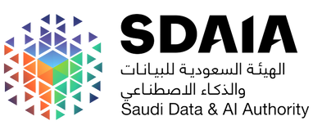




ثاقب | Thaqib
T5 Data Science And Artificial Intelligence Bootcamp
Presentation by :
ATHEER ALMUSAAD - REHAM ALRAJEH - REUOF ALQAHTANI
Suad AlSomali - THEKRA ALQARNI

Slide 2
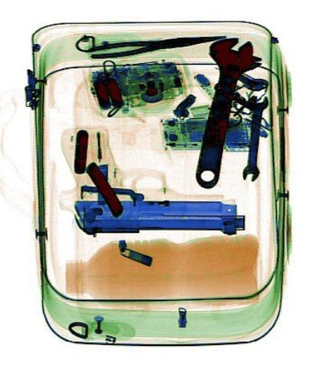
OUTLINE
Problem Statement
Impacts To The Saudi Arabia Vision 2030
Dataset Overview
AI-based Solution ( CNN - YOLOV8 )
Dataset & Model Challenges
Tools
Real-life Application
Demo
Future Work
02

Slide 3
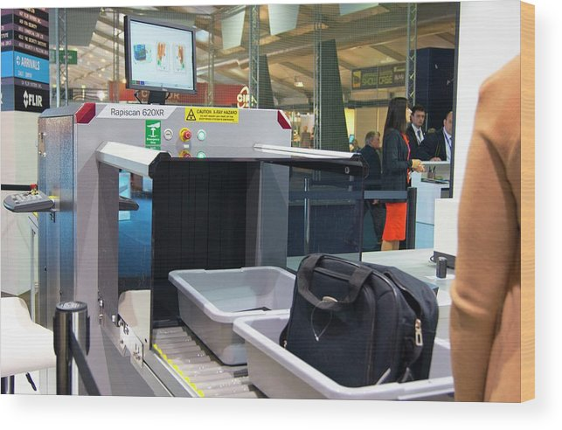

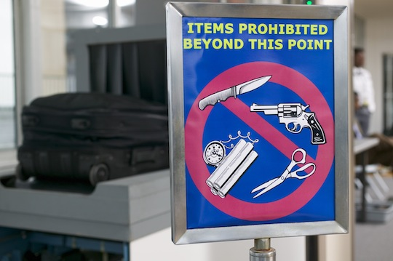
PROBLEM STATEMENT
Objective
Detect dangerous items within the luggage
Enhance to increase the number of passengers
Problem
Manual inspections
Human errors
Solution
Empower human inspectors with AI-based solution for automated detection during X-ray screenings

Slide 4
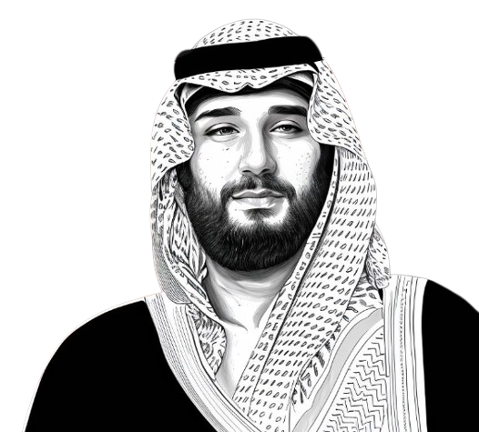





SAUDI ARABIA 2030 VISION
The Ministry of Transport's
Artificial Intelligence
Project Impact
Top logistics hub connecting three continents
Enhance economic diversification
System automates the detection process
Improve government services
Enhancing the Security purpose
Increase number of passengers
Drive innovation across different industries
Raising the level of safety in the transportation sector
Airports, Hotels, Trains, Ports can benefit from using this project
Increasing its tourism target to 150 million visitors by 2030
Reducing manual methods and minimizing human error

Slide 5


بلادنا تمتلك قدرات استثمارية ضخمة، وسنسعى إلى أن تكون محركًا لاقتصادنا
وموردًا إضافيًا لبلادنا وهذا هو عامل نجاحنا الثاني
الأمير محمد بن سلمان

Slide 6



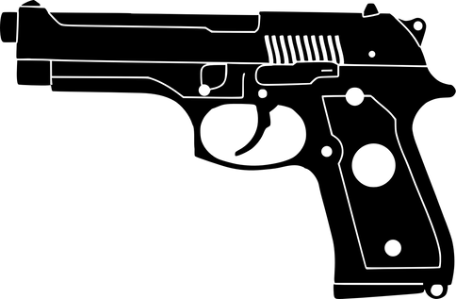

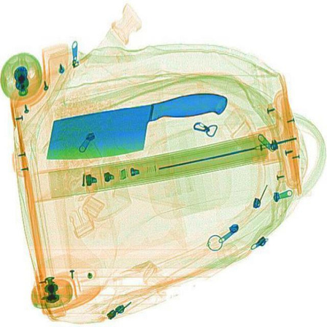
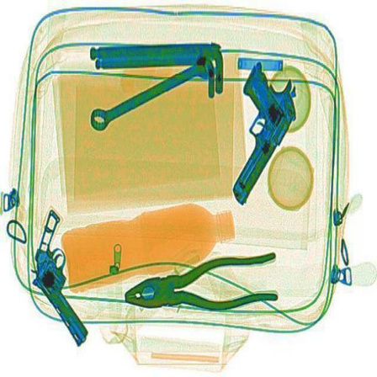

DATASET OVERVIEW
Project Type
Classes
Computer Vision/Object Detection
Wrench
Scissors
Pliers
Knife
Gun
Total Images
8,295 images
Training set: 5,806 images
Validation set: 1,660 images
Testing set : 829 images
Source
universe.roboflow.com

Slide 7
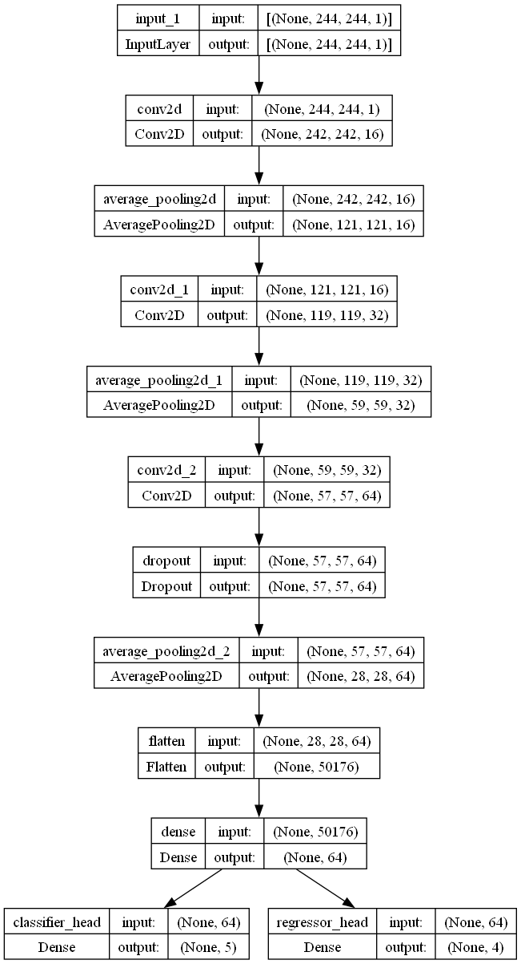
AI-BASED SOLUTION (CNN)
Methodology
CNN(Convolution Neural Network)
CNN Model Usage
Building and training CNN architecture from scratch
Learning of abstract features
Fine-tune the model
Number of layers : 10 layers
Trainable params: 3,235,209
Accuracy: 0.93

Slide 8
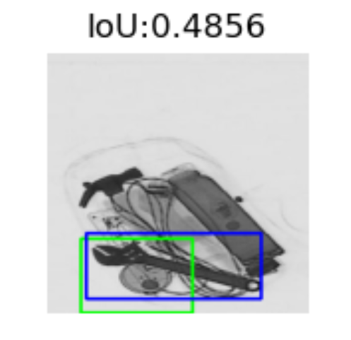
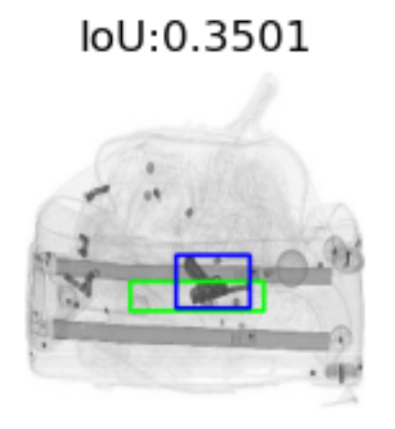
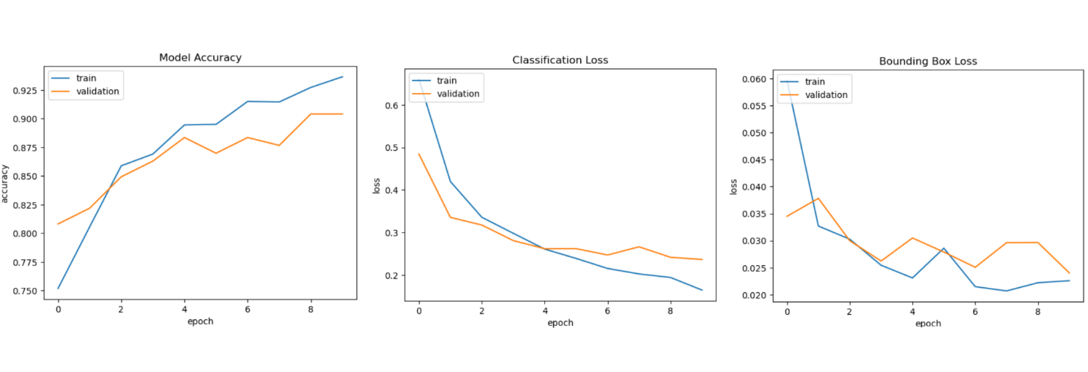
CNN MODEL RESULTS
Blue indicate actual boundary box
06
Green indicate predict boundary box

Slide 9

AI-BASED SOLUTION (YOLYO)
Model Name
MODEL NAME
Source
YOLO (You Only Look Once)
Ultralytics
Vesrion: YOLOv8
YOLOv8 Features
High rate of accuracy
Operates faster, especially on larger images
Predicts bounding box properties directly

Slide 10
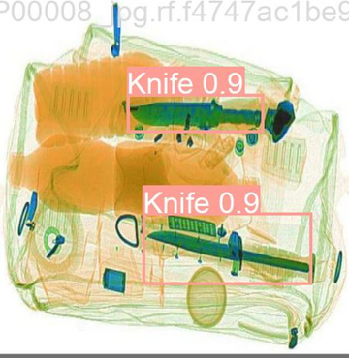
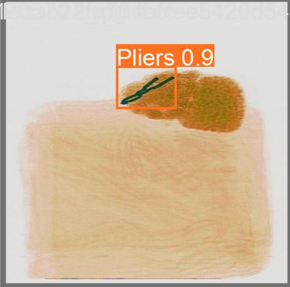
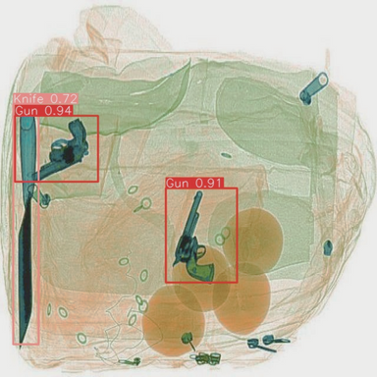
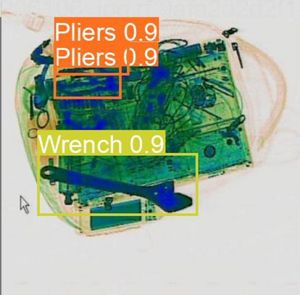
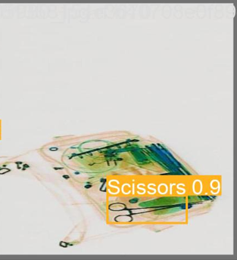
TRANSFER LEARNING: YOLOV8 MODEL
The model establishes boundaries and assigns labels according to the classes in the dataset
Knife
Gun
Wrench
Scissors
Pliers
06
Total layers: 295
Total parameters: 25,859,215
The model achieved a Mean Average Precision (mAP) of 0.94

Slide 11
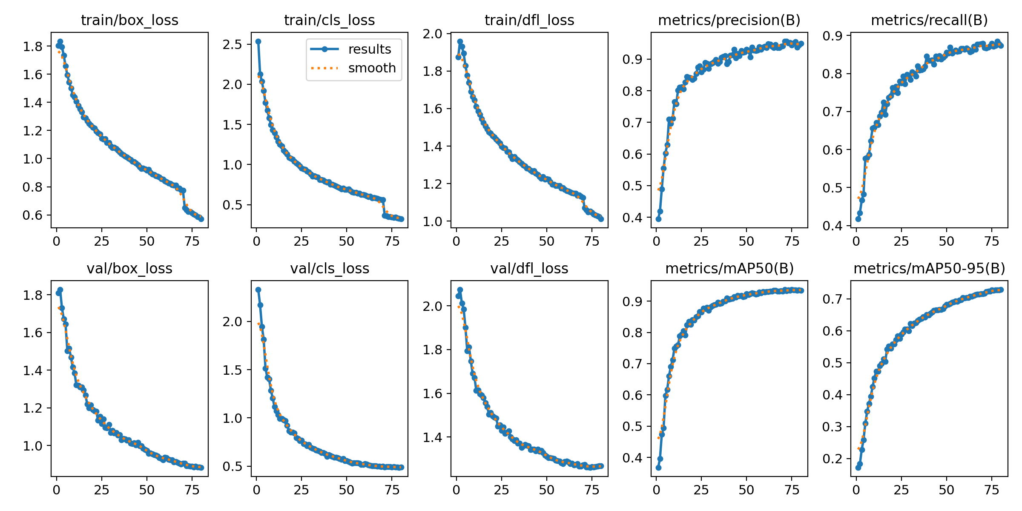
YOLOV8 RESULTS:

Slide 12
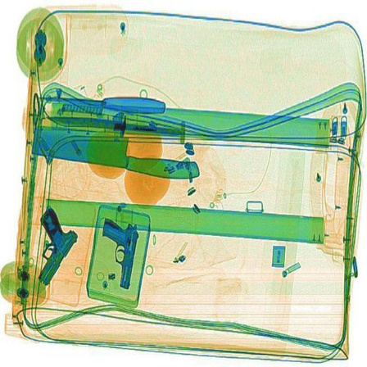
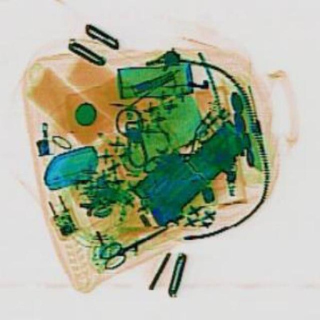
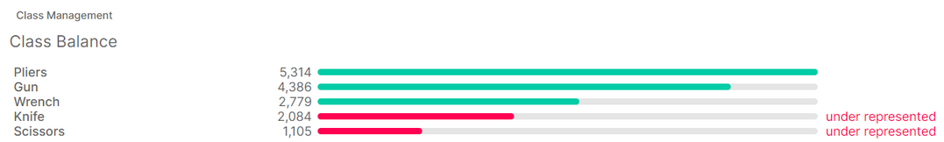
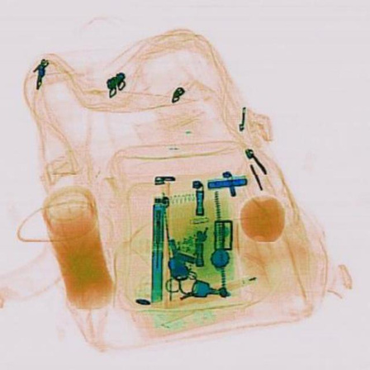
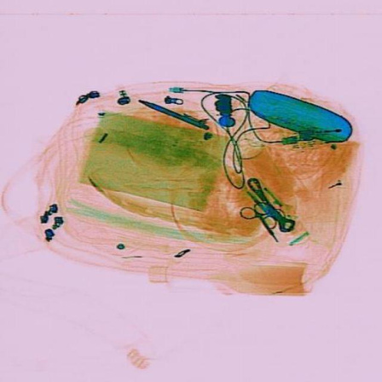
DATASET CHALLENGES
Unbalanced classes
Limited diversity in prohibited items
Variational brightness and, contrast (Different scanning exposure)

Slide 13
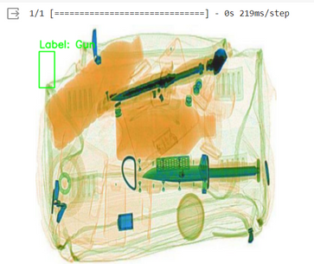
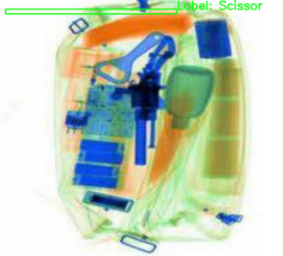
MODEL CHALLENGES
Different Models, Frameworks, and Architectures
Model Performance
Incorrect label and boundaries
Detecto
VGG16
CNN TensorFlow
YOLOv3
YOLOv4
YOLOv5
YOLOv8(used)
Computational Challenges
Limited RAM, CPU, and GPU in hardware
Multi Crash occurs during the training model
Determine the appropriate epochs number
Find the right epochs to reach the appropriate accuracy rate
Overfitting
Perform well on training data, but fail on untrained data.

Slide 14






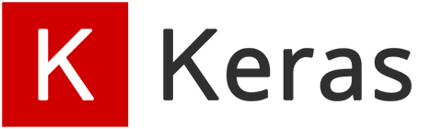







TOOLS
Pre-processing and Visualization
Build Model
Website
Work Space

Slide 15

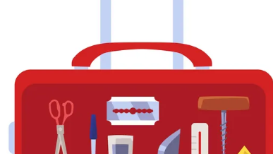
Demo

Slide 16
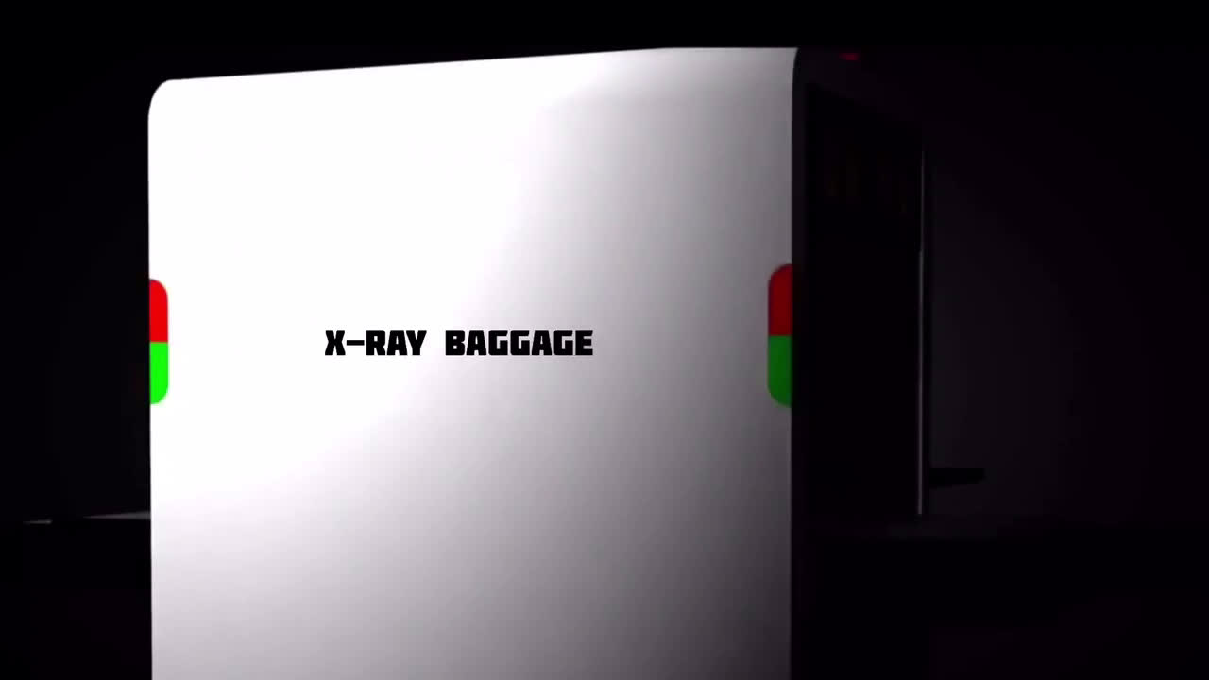
THE APPLICATION OF X-RAY BAGGAGE DETECTION.

Slide 17
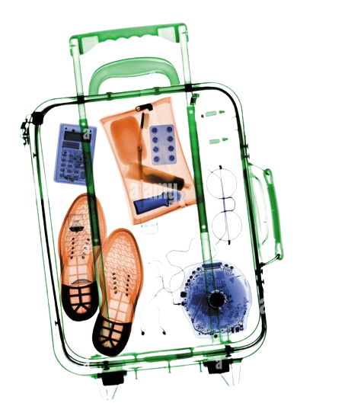
Future Work
Obtaining larger dataset and expanding the range of detectable prohibited items
Implement X-ray Baggage Scanner Detection (Thaqib) on edge devices
Optimizing the system for scalability on multiple environments
Data Analysis of the passenger

Slide 18







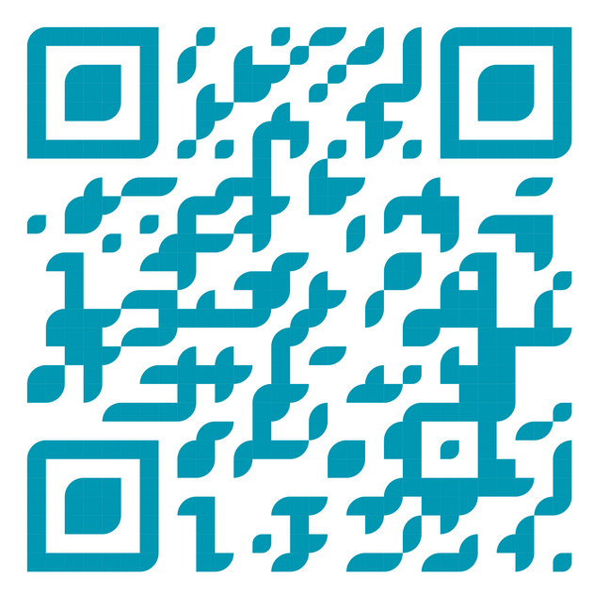
THANK YOU!
ATHEER ALMUSAAD
REHAM ALRAJEH
REUOF ALQAHTANI
SUAD ALSOMALI
THEKRA ALQARNI

